Slide 1

Corporate Bankruptcy Prediction
Ian Bijvoet, Wenyi Zhang, Max Bischot, Vincent Smekens

Slide 2
Motivation & Context
Bankruptcy causes large financial and societal losses.
Early warnings signals are crucial for lenders, auditors, and regulators.
Classical models like Altman Z-score and Ohlsen O-score may be outdated.

Slide 3
Hypotheses
Are there models which can predict bankruptcy better than classical models?
Which financial ratios predict bankruptcy best?
Are smaller firms more predictable than larger firms?
Do failing firms have a higher instability than healthy firms?

Slide 4
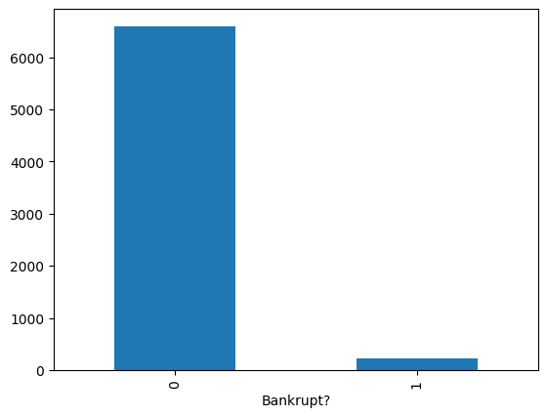
Data
Datasets: Poland, US, Taiwan
Exploratory Data Analysis
Class Imbalance
Data cleaning
Model results
Feature Distributions.
Focus on Taiwanese bankruptcy data.
94 financial ratios.
After cleaning and winsorizing: 6819 rows.
Data cleaning:
Train-test split: 80/20
Z-Score Scaling
SMOTE

Slide 5
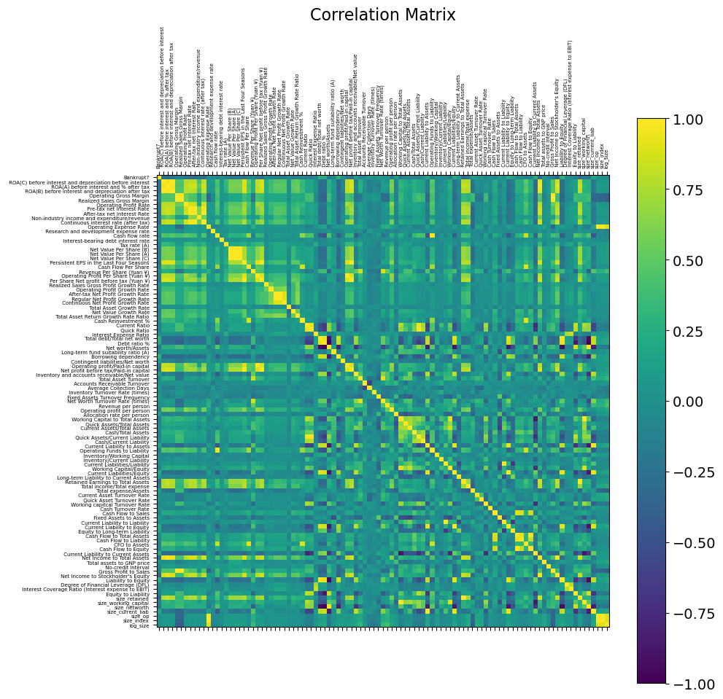
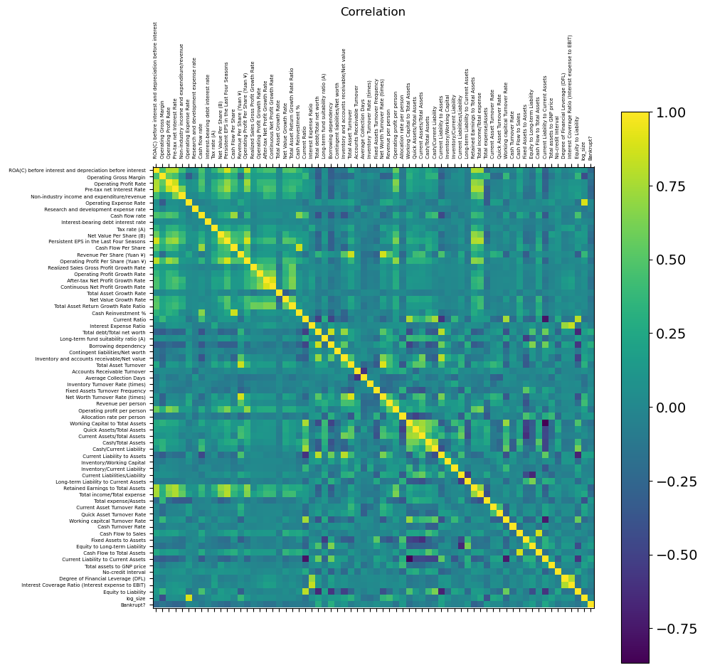
Multicollinearity
Drop column if correlation > 0.90.
After which there are 67 columns left.

Slide 6
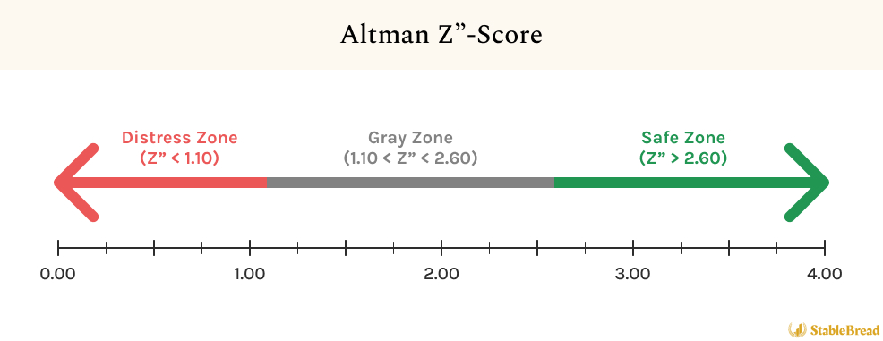
Classical Models
Altman Z-score
Ohlson O-score
Edward. Altman (1968)
James Ohlson (1980)
5 key financial ratios.
9 key financial ratios.

Slide 7
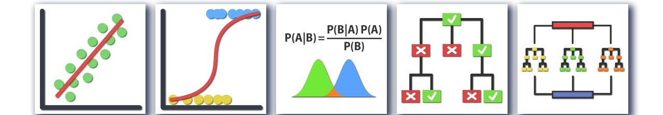
ML Models
v
We tested four types of ML models on the Taiwanese dataset.
SMOTE was applied to handle strong class imbalance (only about 3% bankrupt).
Logistic Regression gives stable baseline performance.
Random Forest and XGBoost capture non-linear relationships.
KNN is a distance-based and sensitive to scaling and imbalance.
We compare model performance in terms of AUC, Recall, Precision and F1.

Slide 8
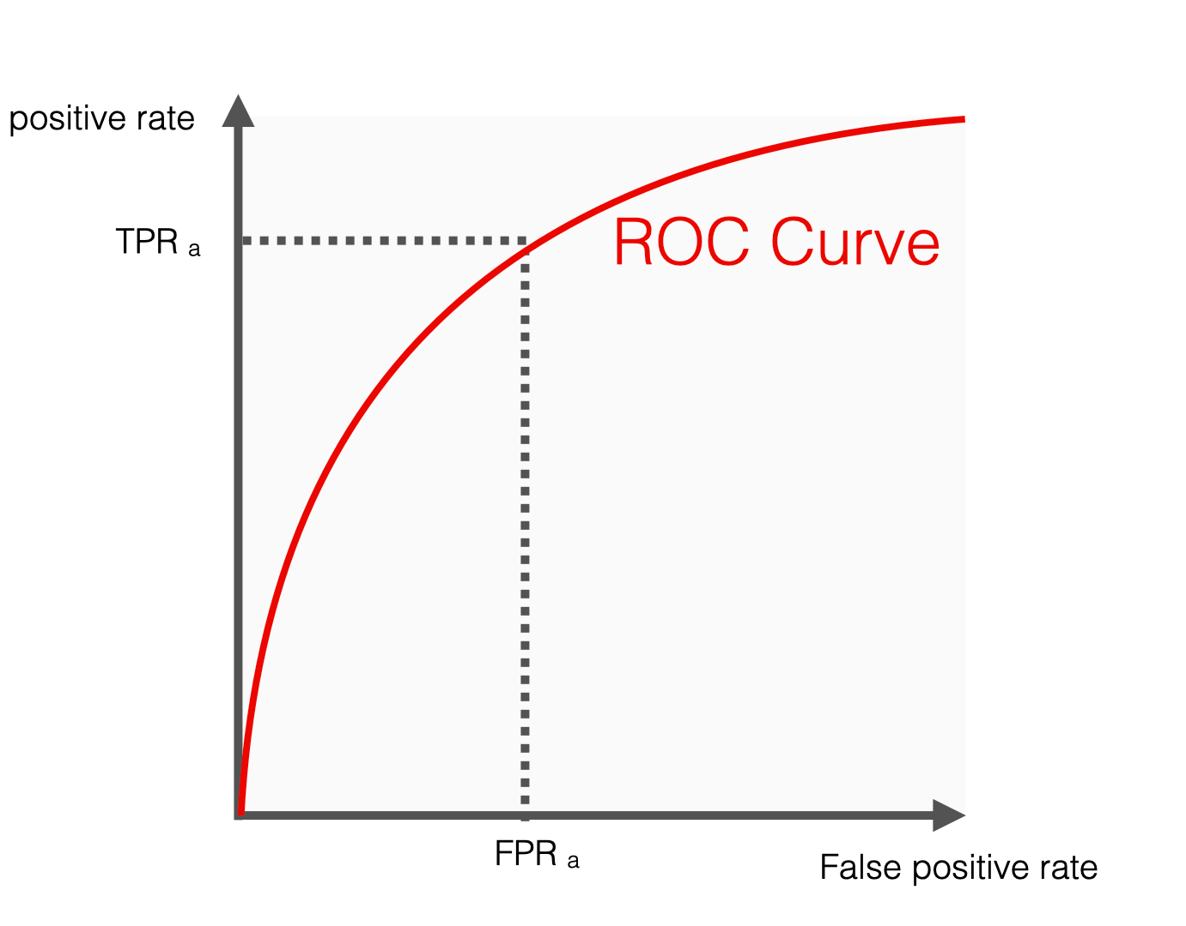
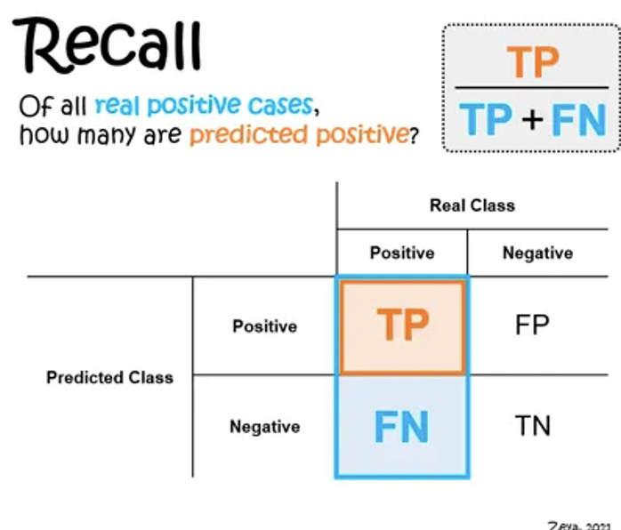
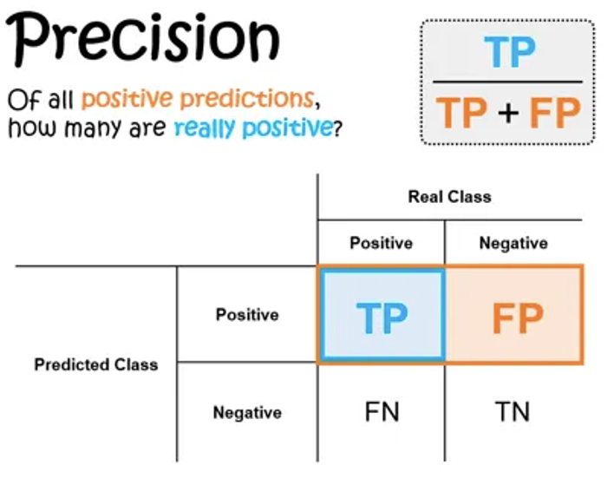
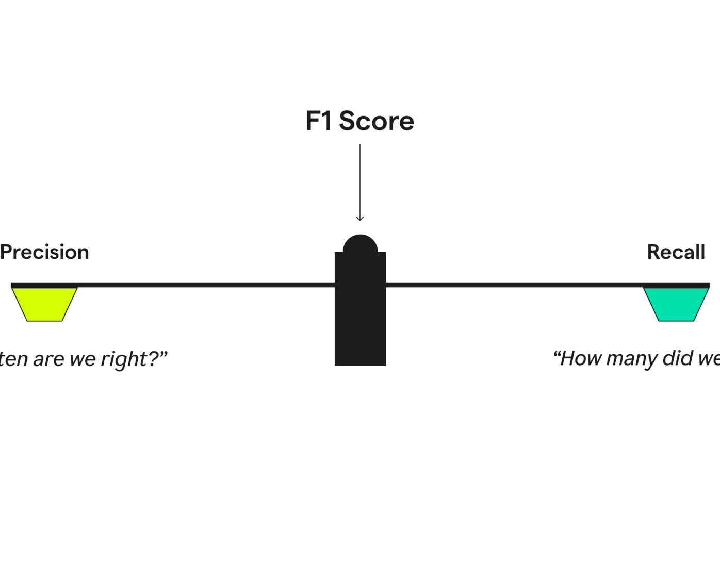
Evaluation metrics
AUC
Recall
Precision
F1
Binary classification.
Sensitivity vs specificity.
Overly optimistic.
True positives.
Does not factor false positives.
How often is the prediction correct?
Works well imbalanced classes. Does not take into account false negatives.
Harmonic mean.
Balanced.

Slide 9
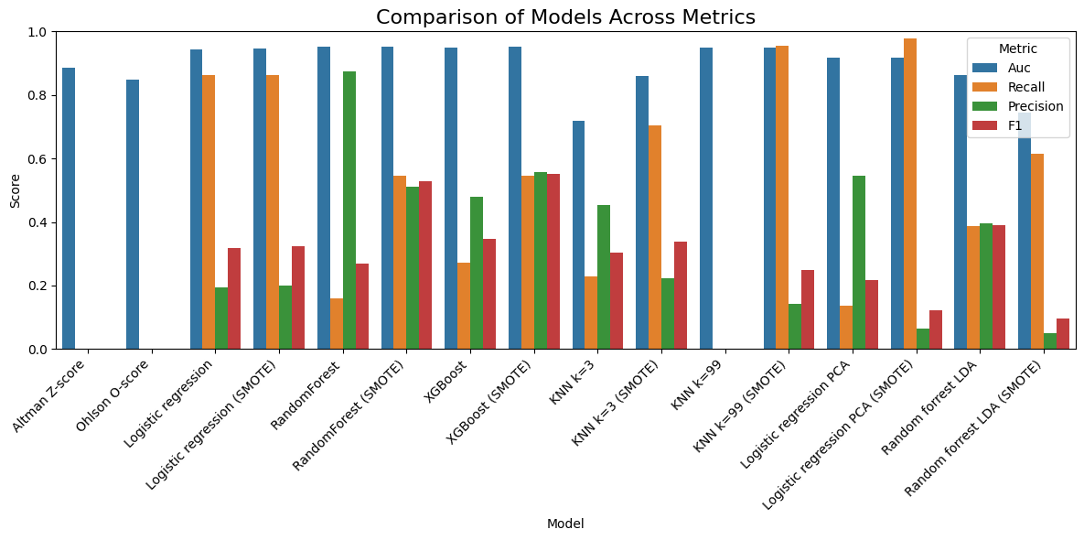
Model Comparison

Slide 10
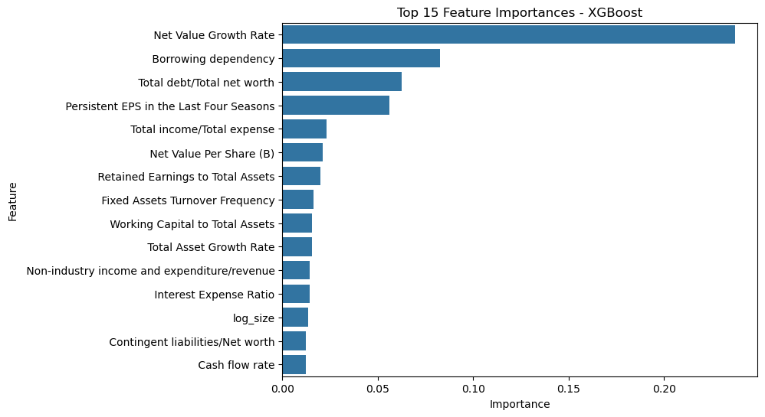
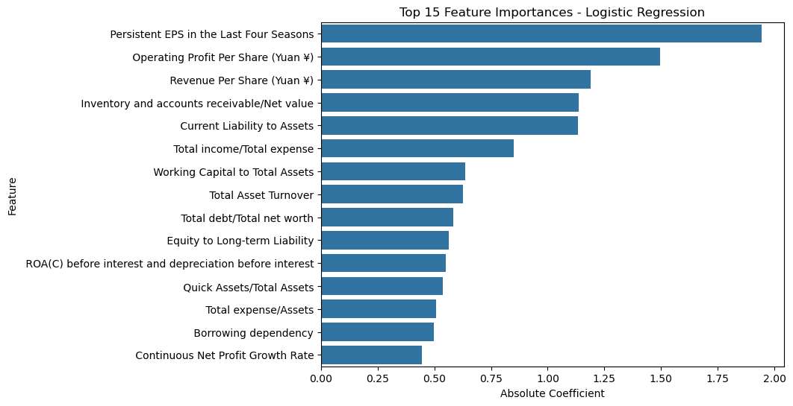
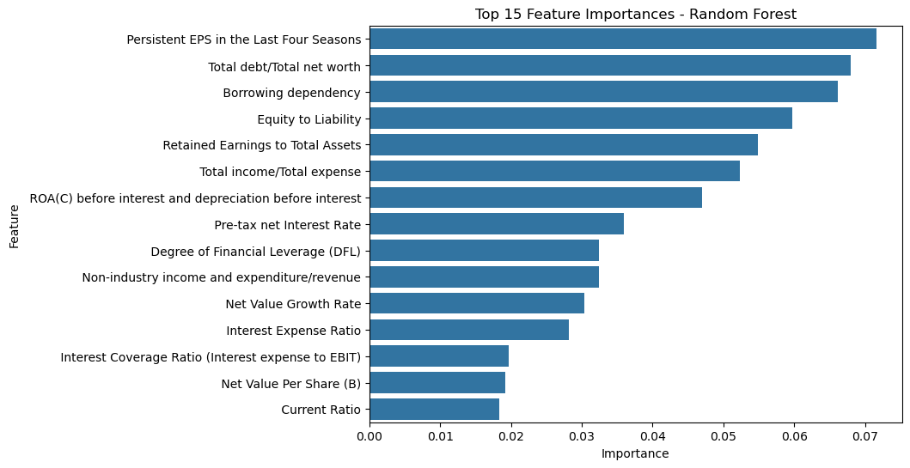
Financial Ratios
Top ratios across models: Persistent EPS, Borrowing dependency, Total debt / net worth
Reflect earnings stability and leverage risk
Logistic Regression highlights profitability
Random Forest & XGBoost emphasize leverage and firm value growth

Slide 11
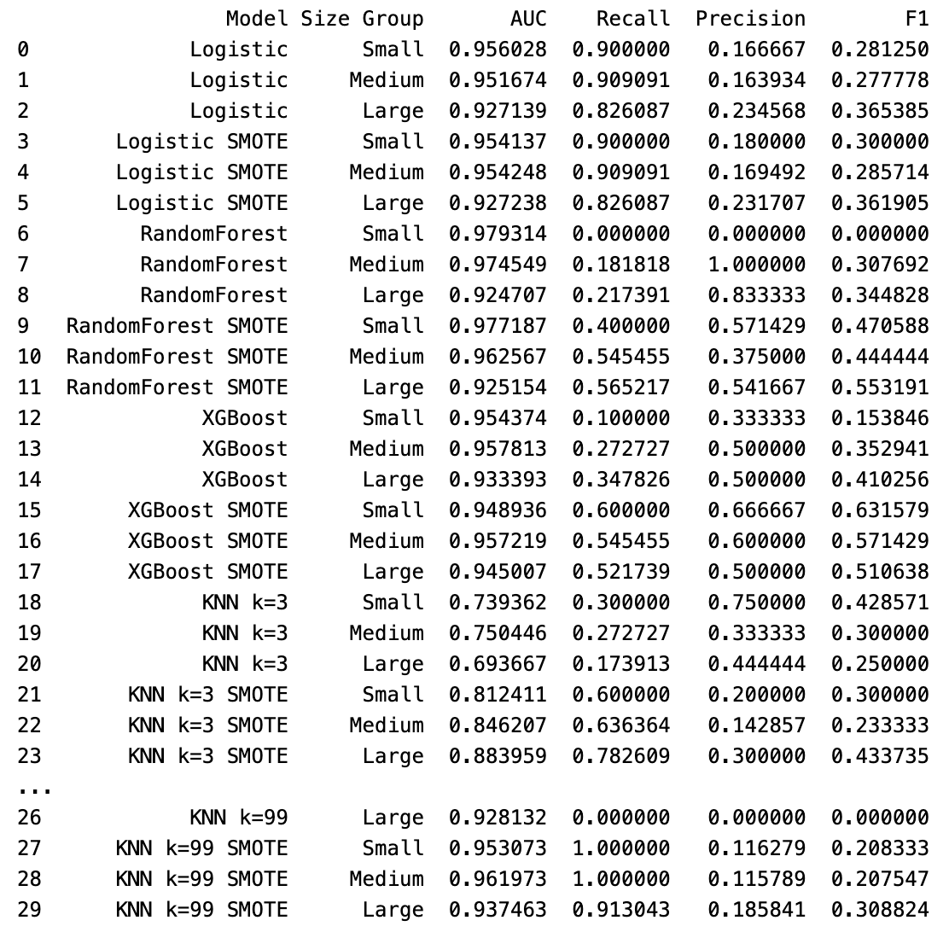
Firm size analysis
Small, Medium, Large
Log-proxy: Total assets to GNP price
AUC & Recall

Slide 12
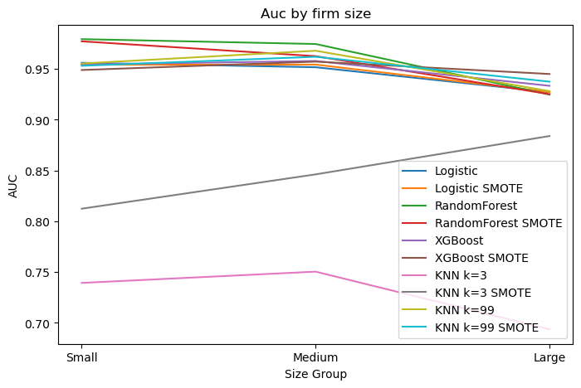
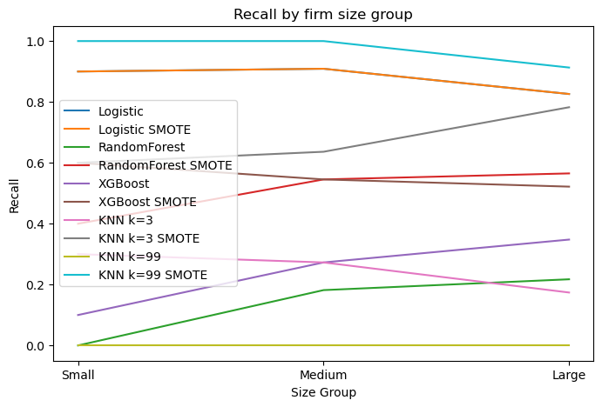
AUC & Recall vs Firm size

Slide 13
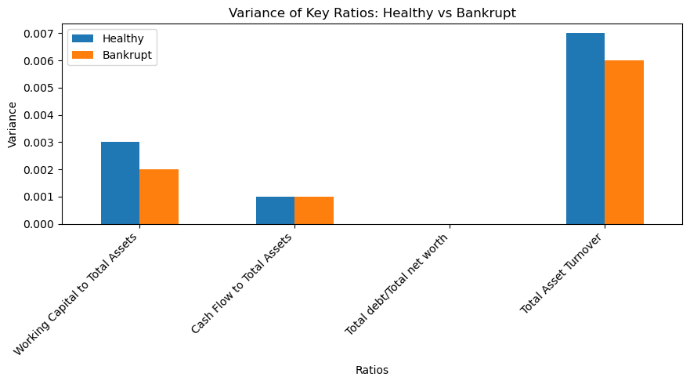
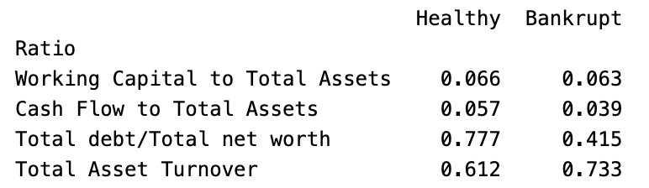
Variance analysis
Working Capital to Total assets (Liquidity ratio)
Cash Flow to Total Assets (Liquidity/Performance ratio)
Total Debt to Total Net worth (Leverage ratio)
Total Assets Turnover (Efficiency ratio)

Slide 14
Limitations
Missing variables for the Altman Z-score and Ohlson O-score
Verifying data for outliers
Class imbalance

Slide 15
Conclusion
ML models outperform classical models overall.
Key predictors across models are Persistent EPS, Borrowing dependency, and Total debt / Total net worth.
SMOTE increases recall but often lowers precision, reflecting the trade-off in bankruptcy detection.
Smaller firms tend to be slightly easier to distinguish, though results vary by model.

Slide 16

Plaats hier de titel van de dia
This Photo by Unknown Author is licensed under CC BY-SA-NC

